Slide 1
MP5 – Forensics Checkpoint 2
CS461/ECE422 Fall 2018
Week of 12/3 – 12/7

Slide 2
Outline
Attacker Mindset – Defending against Forensic Analysis
Analyzing File Metadata with Exiftool
Geolocation
Password Cracking
File Recovery
Final Note on Scenario

Slide 3
Attacker Mindset - Discussion
If you were a criminal, and you knew there was evidence of your crimes on your computer, how would you secure your computer against forensic analysis? Why?
Notes:
Name files cryptically or deceptively
Encrypt incriminating files
Full disk encryption (probably the best answer)
Delete data if not started up properly (related to MP). You can talk about how specifically someone might go about doing this.

Slide 4
Analyzing File Metadata

Slide 5
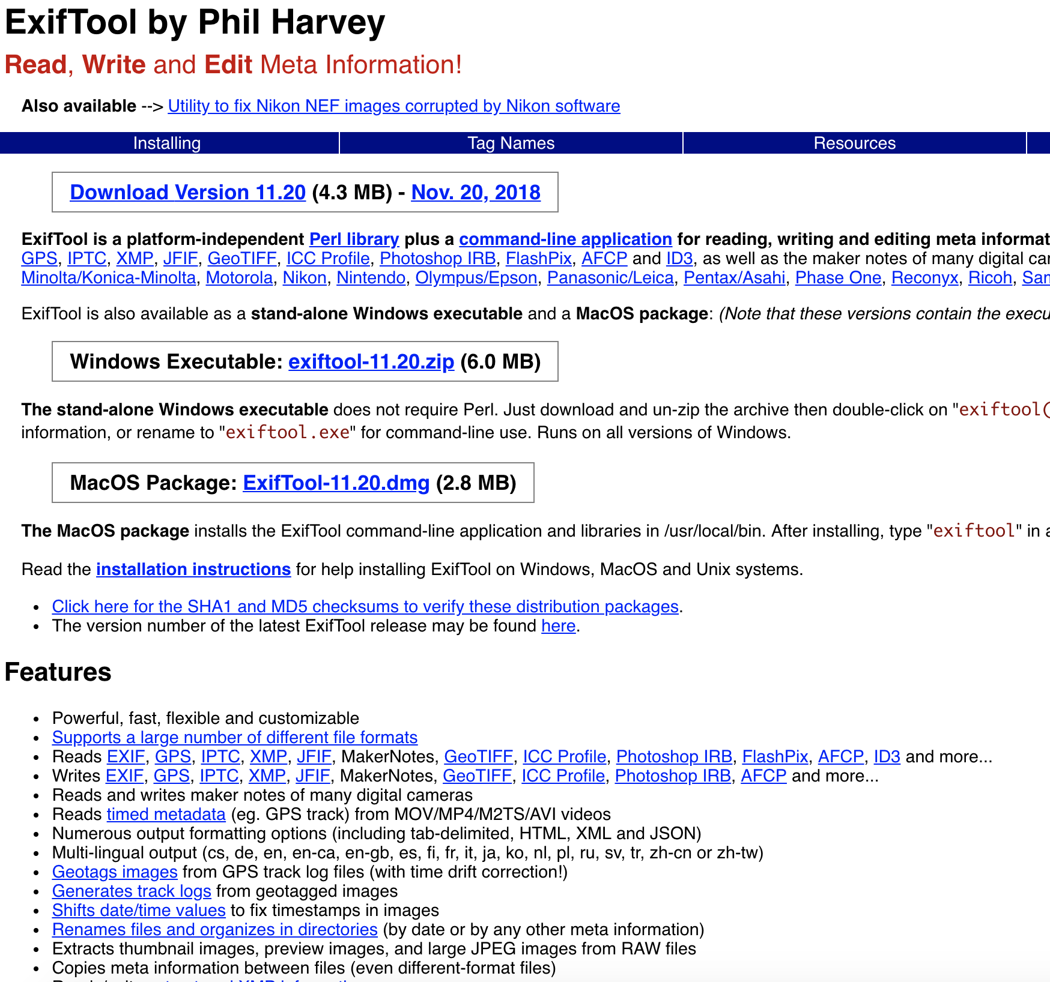

Slide 6
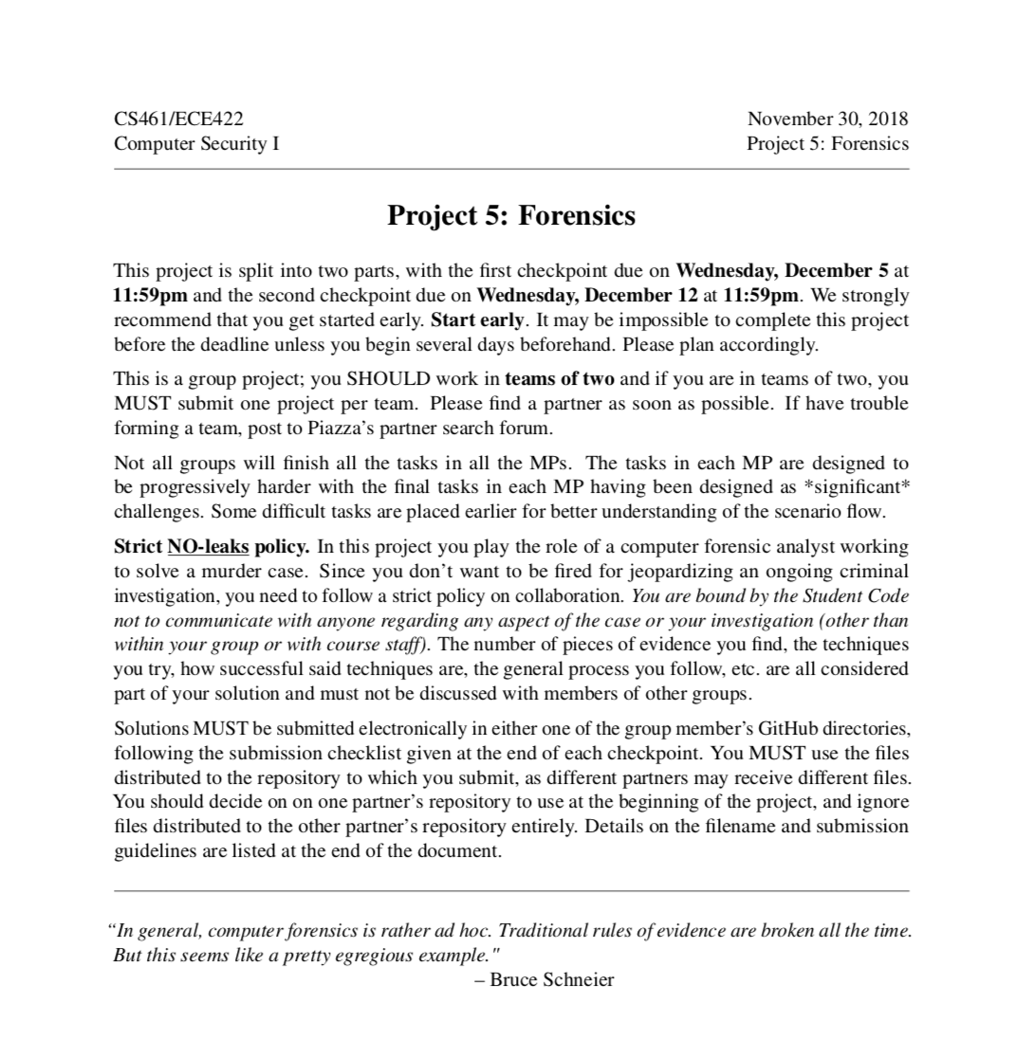
Exiftool

Slide 7
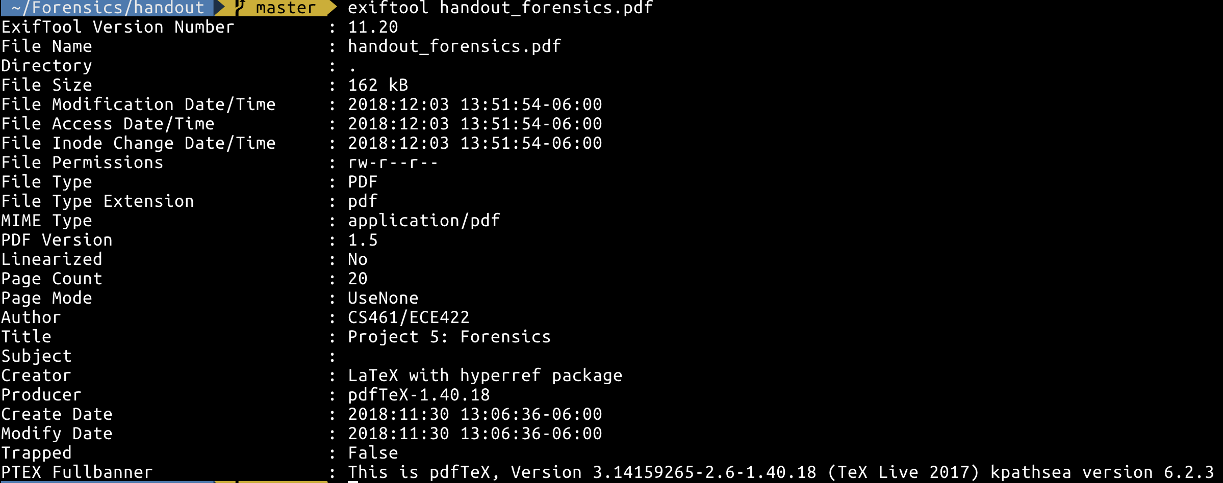
Exiftool

Slide 8
Exiftool

Slide 9
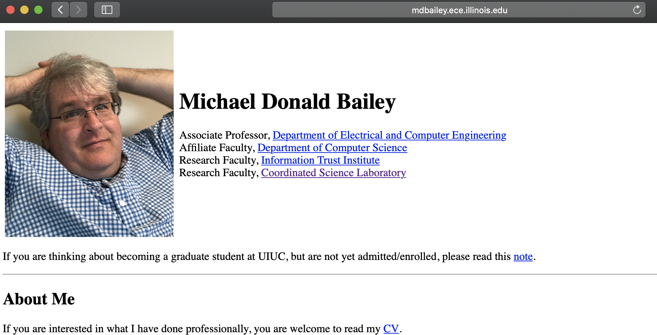
Exiftool

Slide 10
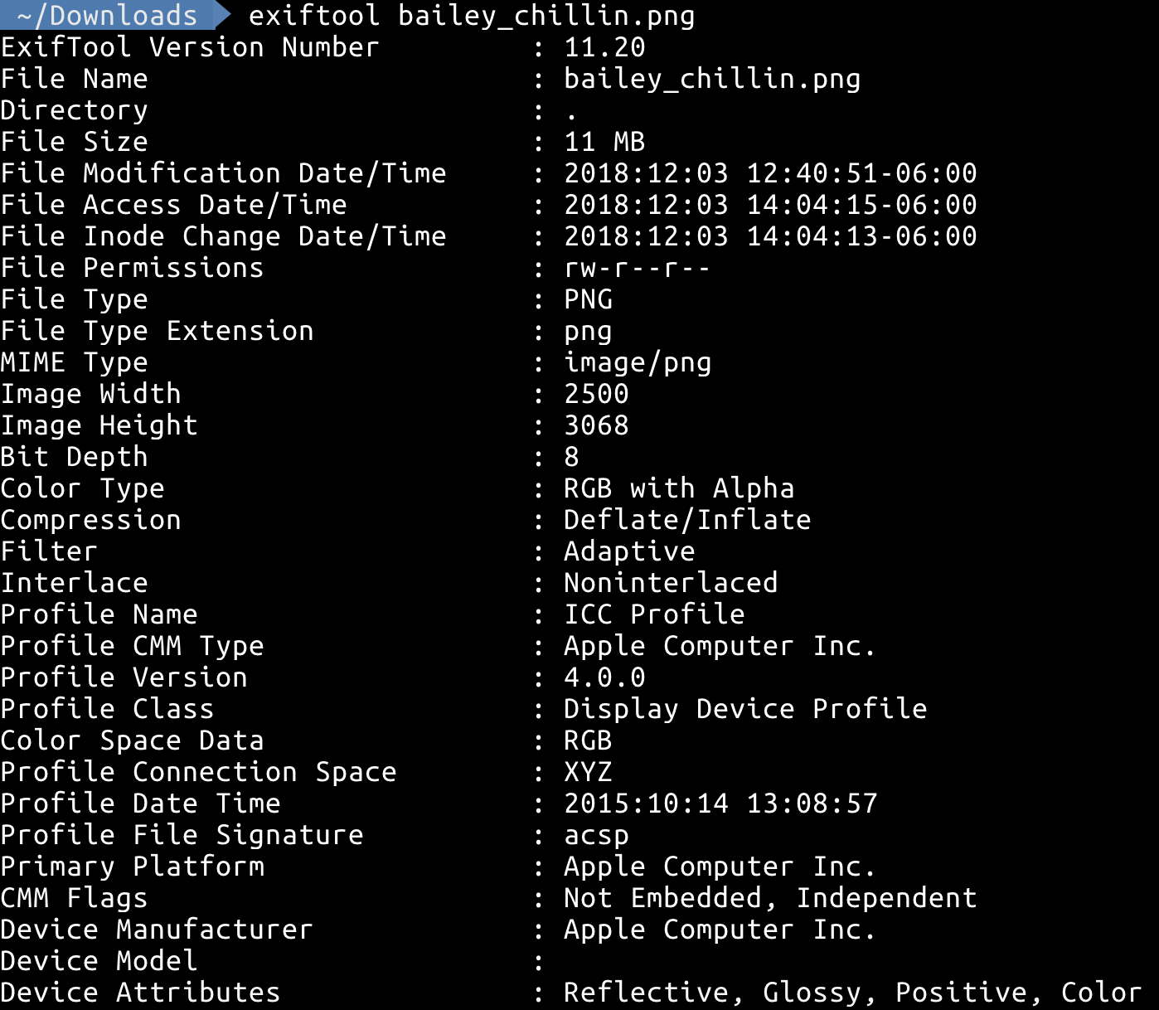
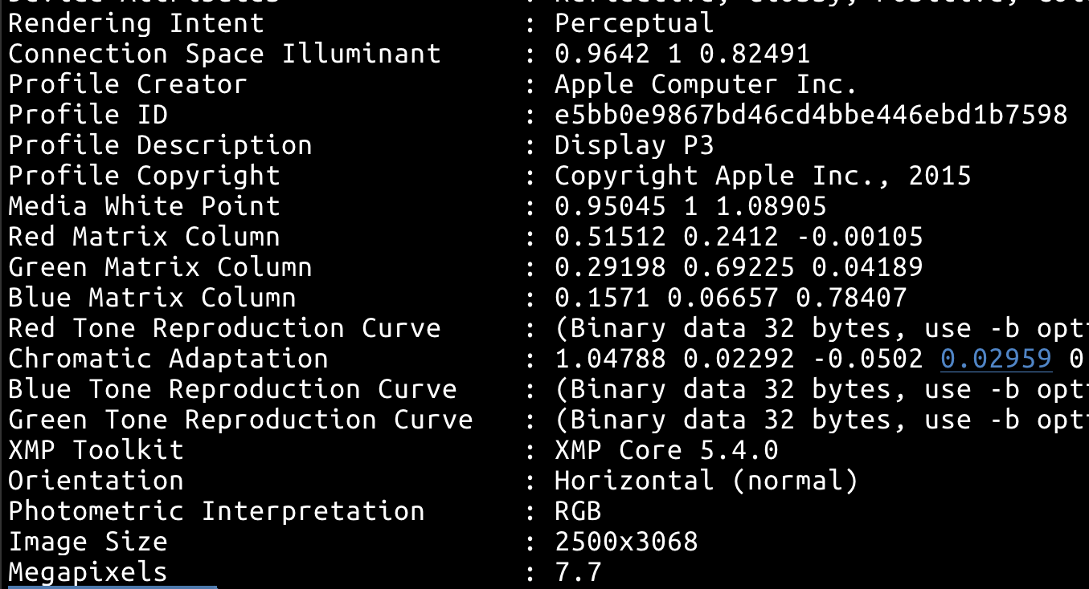
Exiftool

Slide 11
Exiftool

Slide 12
Exiftool
Notes:
Let’s say you find this photo showing the location of a murder. What now?

Slide 13
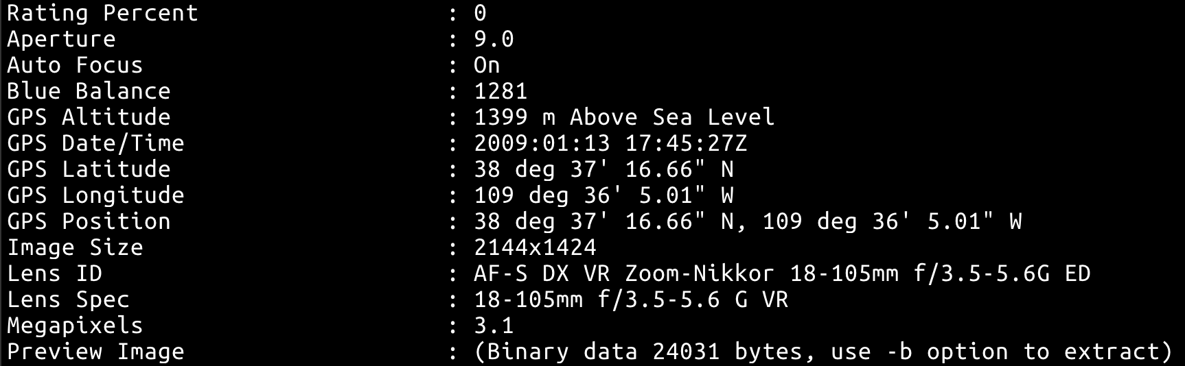
Exiftool

Slide 14
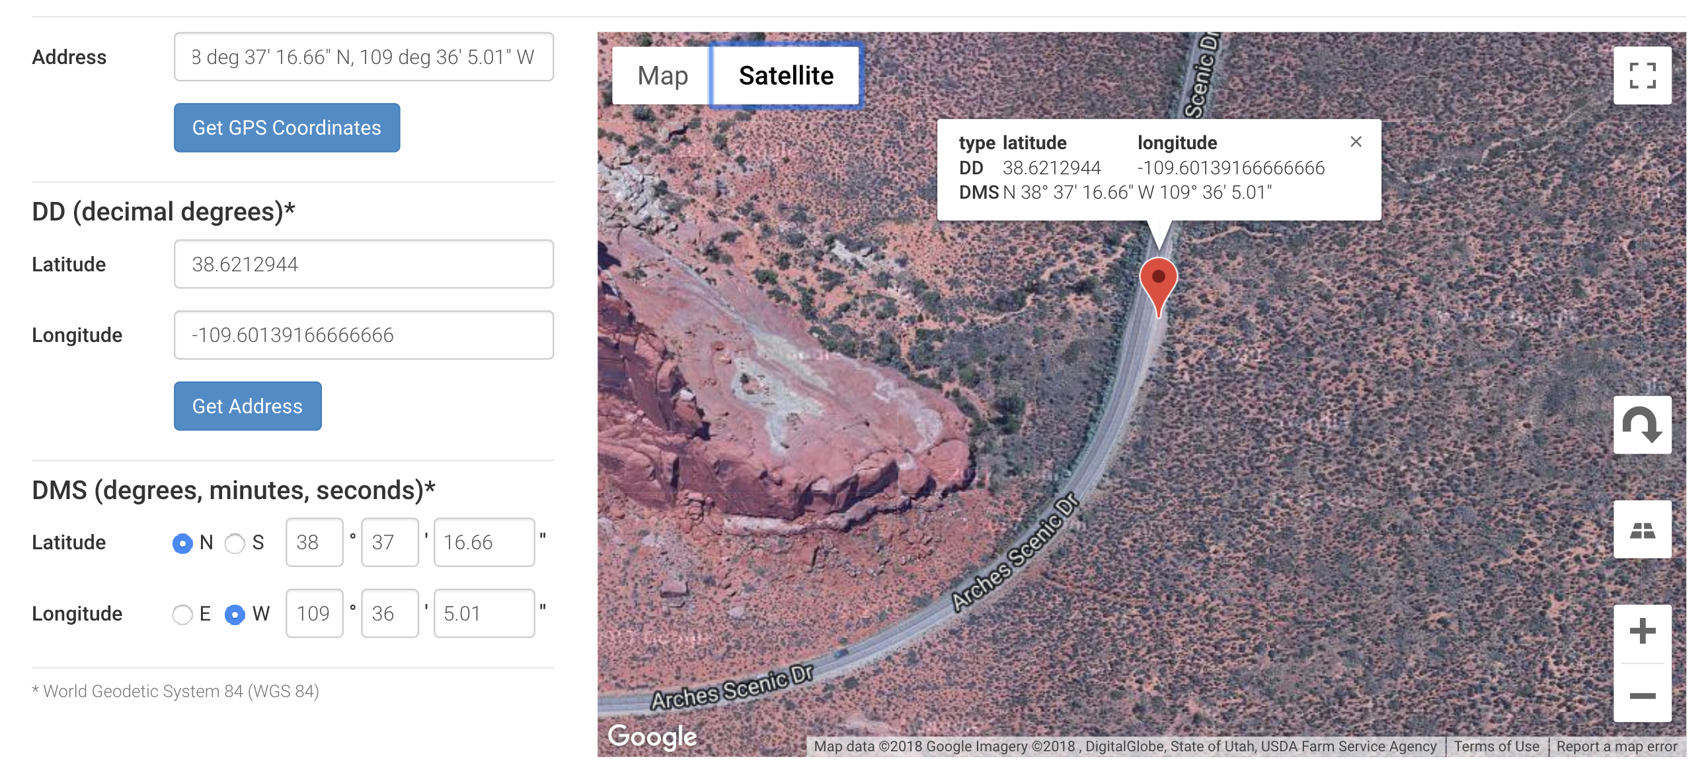
Geolocation
Notes:
Location: Arches National Park, UT

Slide 15
Password Cracking
MUST be done on your personal computer
Tools:
John the Ripper (Crack passwords offline)
Fcrackzip (Crack encrypted zip files)
Pdfcrack (Crack encrypted PDFs)
Hydra (Crack SSH passwords)

Slide 16
Password Cracking – Best Practices
Try cracking a simple password first to make sure your setup is right
Wordlists are WAY faster than brute force
One good wordlist: rockyou.txt (http://downloads.skullsecurity.org/passwords/rockyou.txt.bz2)
For the purposes of this MP, if a password cracker has been running for longer than 10 min, you should reevaluate your approach

Slide 17
File Recovery
Autopsy is good at showing the metadata of files that have been deleted, and it has modules which try to extract content
However, in some cases, these modules may fail
Think of creative ways to recover a deleted file
Everyone should be able to recover at least one deleted file somehow
There may be a file that is visible, but where the content is not recoverable

Slide 18
Final Note on Scenario
In the final question, you are asked to decide whether your suspect is guilty or not
Researching and making a plan is not enough to incriminate someone
You must have some evidence/reasoning that they actually followed through with it!

